Slide 1
Tables – a data structure for learning Data Science
David Culler, EECS
Summer Data Science Short course
Also: https://github.com/deculler/DataScienceTableDemos

Slide 2
Four Pedagogical Pillars
Create computational document / data narrative
Raw data & question => sequence of refinements, analyses, additional viewpoints => observation or answer
Tables – a single data structure for all
Draws on spreadsheet intuition, without the “programing cliff”
Build intuition for R, SQL, PANDAS, …
Learn computing concepts in statistics context
Learn statistical concepts in a computing context

Slide 3
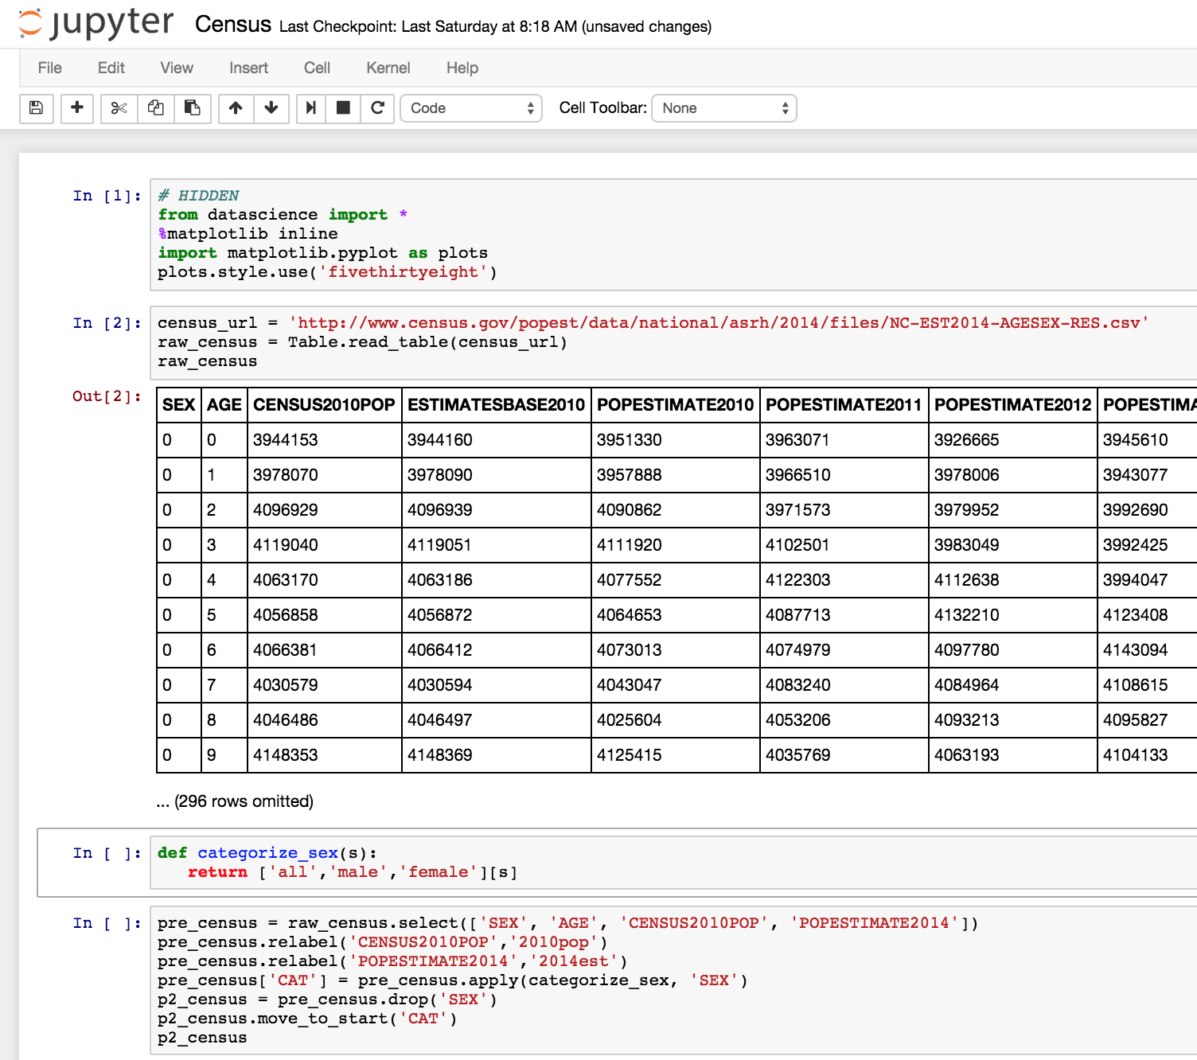


Data8 Student View
Notes:
Computing on real world data in the cloud
- creating computational documents (digital narrative)
- using a single, powerful data structure – Tables
- learning computational concepts while approaching statistics
- learning statistical concepts through computation

Slide 4
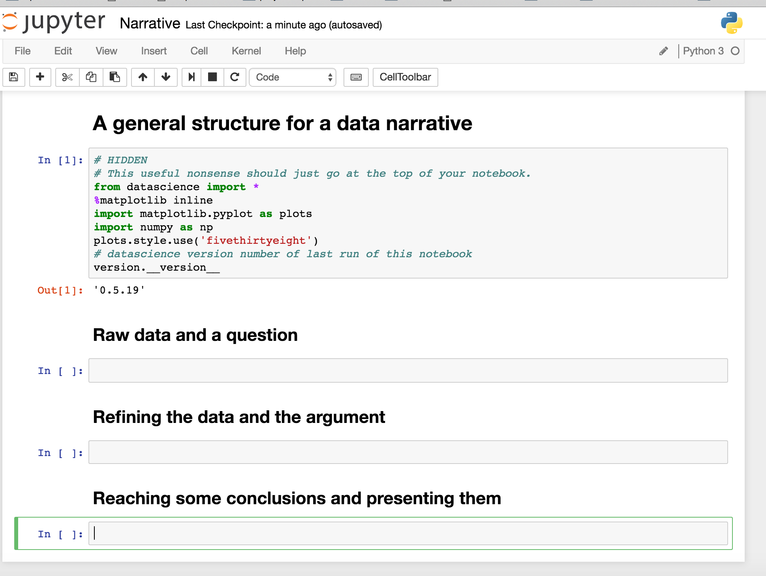
A Computational Document

Slide 5

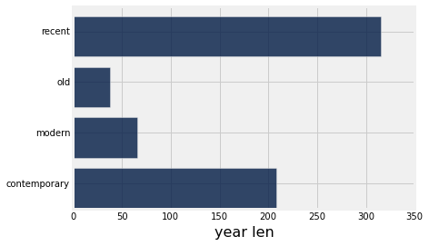
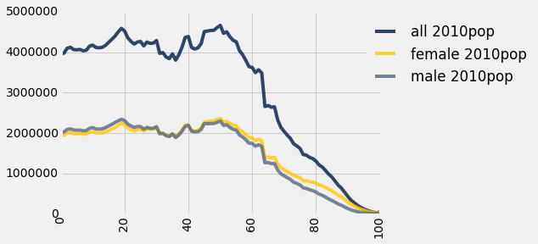
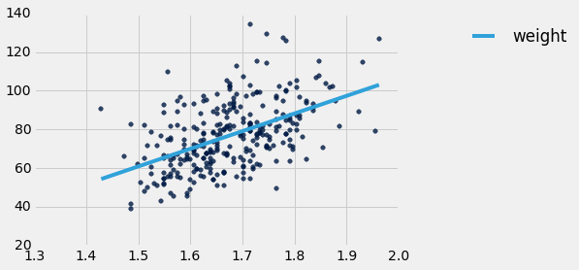
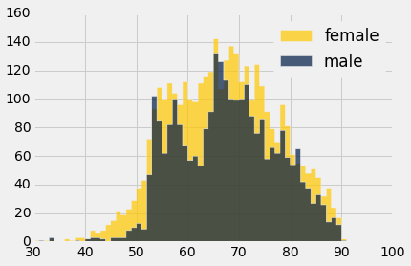
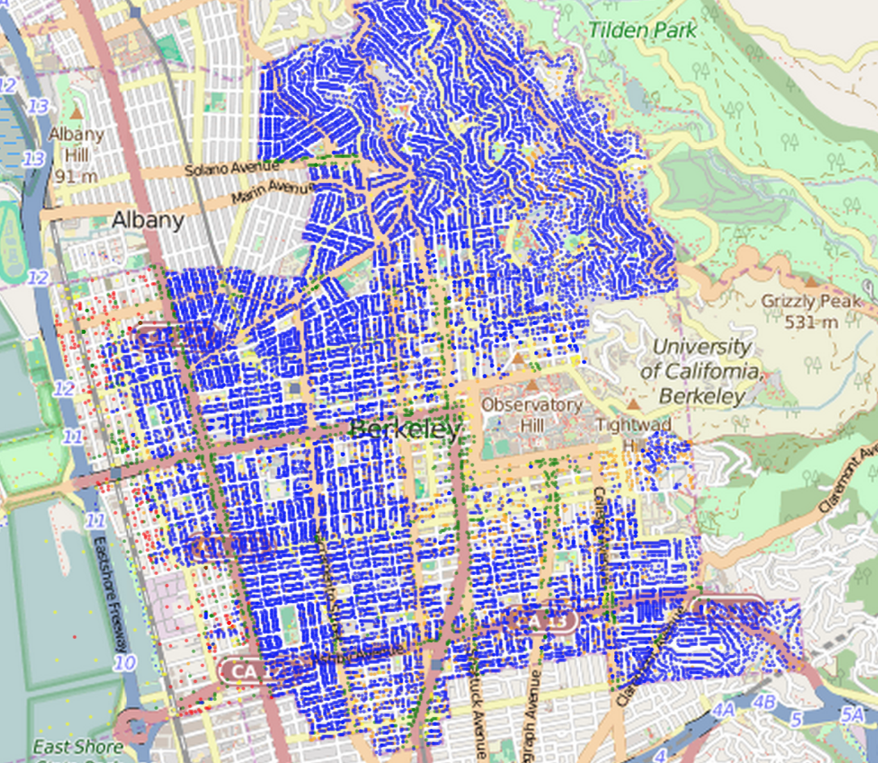
Tables (https://github.com/dsten/datascience)
ordered collection of labeled columns of anything
label
select, where, take, drop, group
stats, bin
sample
dict, record,tuple
pivot, pivot_bin
values
split
join
Numpy array
T[‘label’]
A single, simple, powerful data structure for all
Inspired by Excel, SQL, R, Pandas, Numpy, …

Slide 6
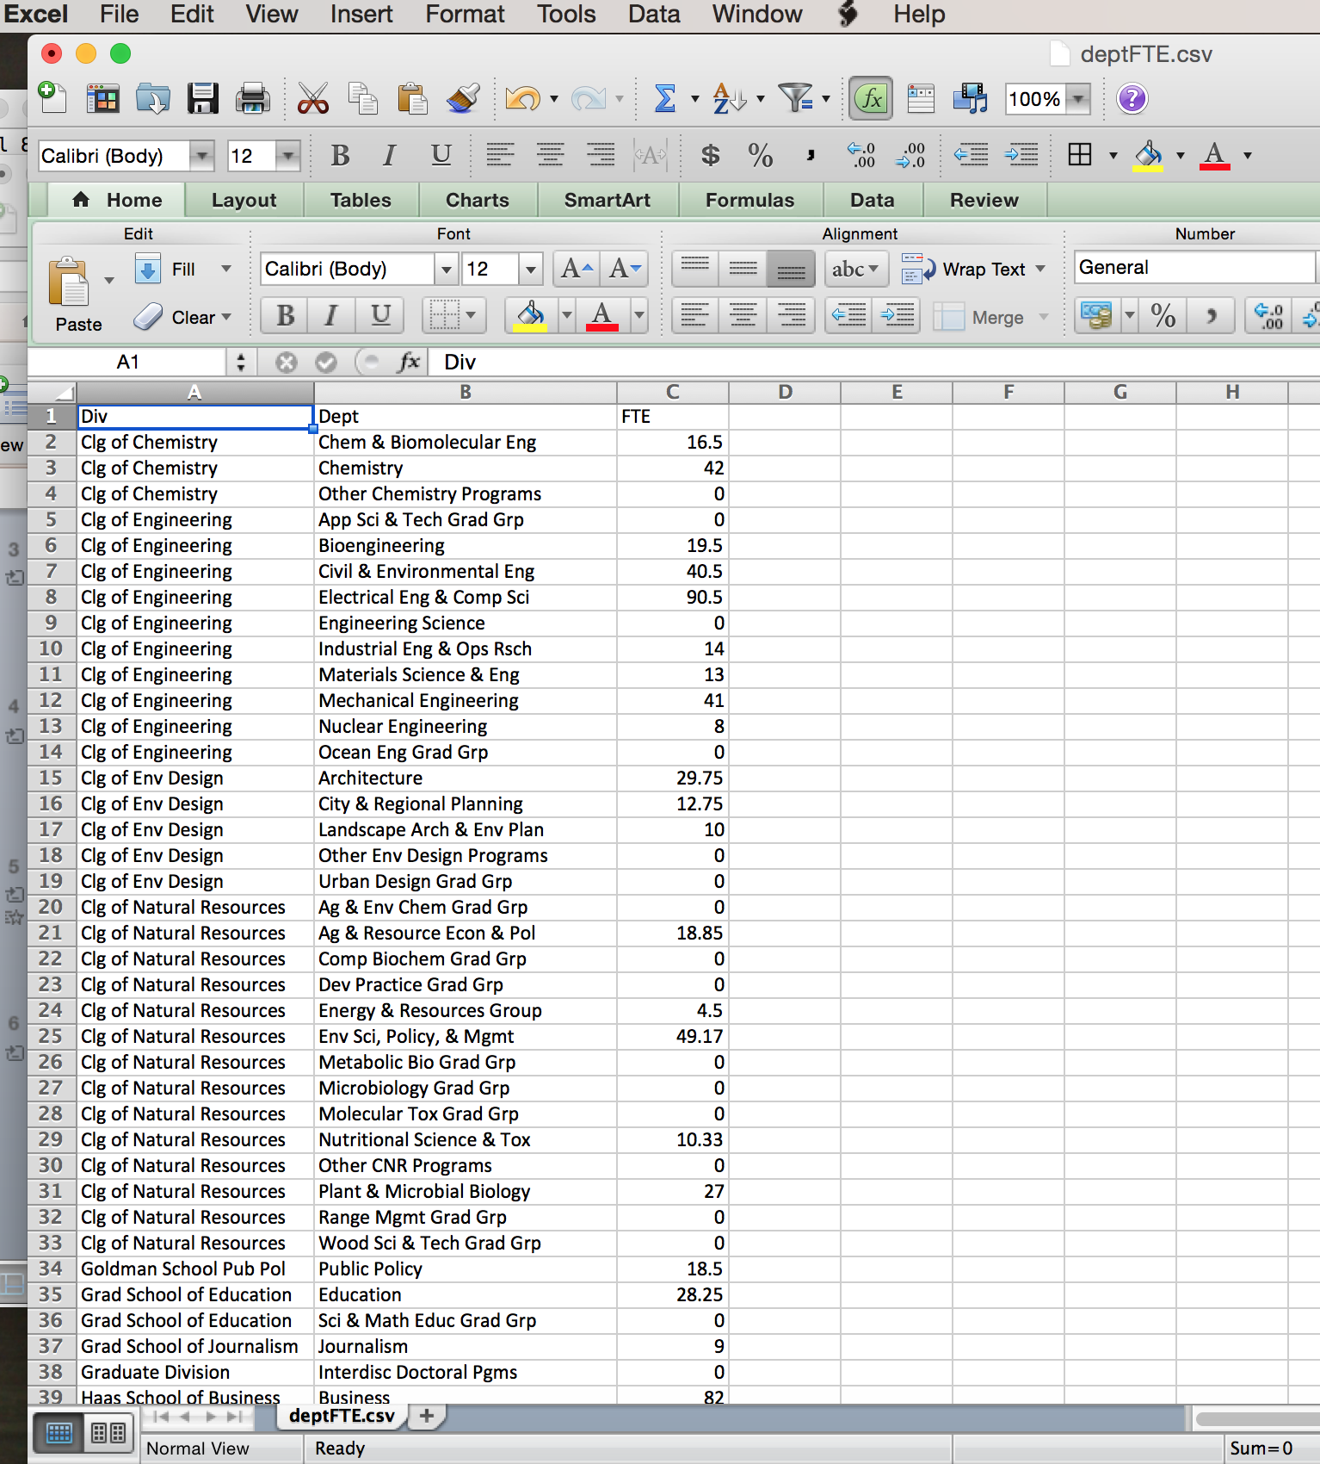
Some data

Slide 7
Creating a table from data
label
values
Table.read_table( <path> )
- read labeled columns of data into a Table

Slide 8
Create a new table where a predicate is satisfied
label
label
values
Table.where( <label and value or predicate> )

Slide 9
Create a new table of descriptive stats
label
stats
label
summary
values
summary
Table.stats( <optional list of operations> )
- each row is a distinct operator computing over the elements in the column

Slide 10
Create a new table by selecting certain columns.
label
label
values
values
Table.select( < label or list of labels > )

Slide 11
Visualize columns in a table
ordered collection of labeled columns of anything
label
values
Table.bar( < … > )
Table.barh( < … > )
Table.plot( < … > )
Table.scatter( < … > )

Slide 12
Create a new table by sorting all rows according to a column of keys
label
label
values
values
Table.sort( < label or column of keys > )

Slide 13
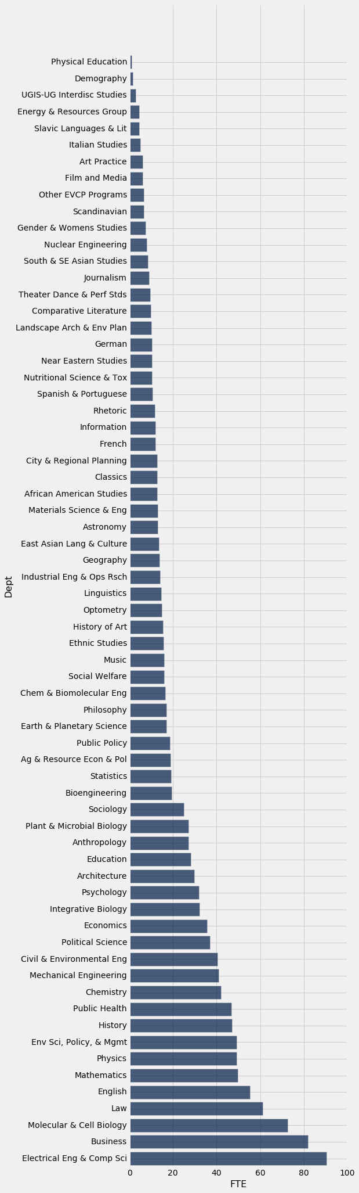
Composition
label
label
values
values

Slide 14
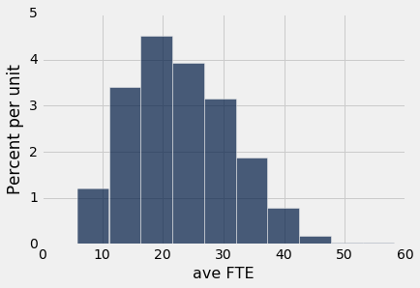
Frequency analysis on a Table
ordered collection of labeled columns of anything
label
Table.hist( < … > )
Table.pivot_bin( < … > )
values
Table.bin( < … > )
bins
label

Slide 15
Indexing a column of a table yields an array of values in the column
label
T[‘label’]
values
numpy array

Slide 16
Data parallel operations
Rather than writing tons of code to compute every individual value, operate on the entire data object

Slide 17
Assigning to a table updates it with a labeled column
T[col] = < array >
label
col
values
numpy array

Slide 18
Creating a new table with additional columns from a possibly empty table
label
label
col
values
values
numpy array
Table.with_column( <label>, <data>)

Slide 19
Create a new table by grouping rows according to a column of keys and applying a function to each group
label
label
values
Table.group( <col>, <op> )

Slide 20
Create a new table that is a sample of the rows of a table
label
label
values
Table.sample(<size>)

Slide 21
Create a new table by pivoting on the distinct values in group of columns to form the new cols and a column of rows
label
values
Table.pivot(columns, rows, ... )

Slide 22
Create a new table that is a join of matching rows in two tables
label
label
label
values
values
Table.join(col, other, other-col)

Slide 23
Where to go for more
http://data8.org/datascience/tables.html
https://github.com/deculler/DataScienceTableDemos

